Slide 1
Activity curves
Case epilepsia Case exitus

Slide 2
Case epileptic seizure:
Patient had Vivago watch on ankle because the seizure was much more visible from legs.
Epileptic seizures are marked with a flag
Nurses were informed with alarm type –high activity. With Vivago system the personal settings were used to optimize the personal circadian rhythm and that allowed to see as well the seizures as deviation to normal.

Slide 3
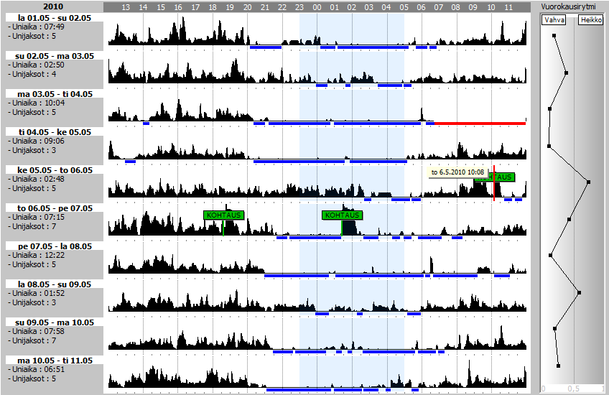

Slide 4
Vivago’s activity curves can support detecting a epileptic seizure
An epilectic seizure is very individual and it is almost impossible to recognize ir because it can occur in many different ways. By individual care and by knowing the patient an epileptic seizure can be catched bu using Vivagos activity curves.
In this case the patient suffered from tonic clonic epileptic seizures. The nurses decided to activate an high activity alarm.

Slide 5
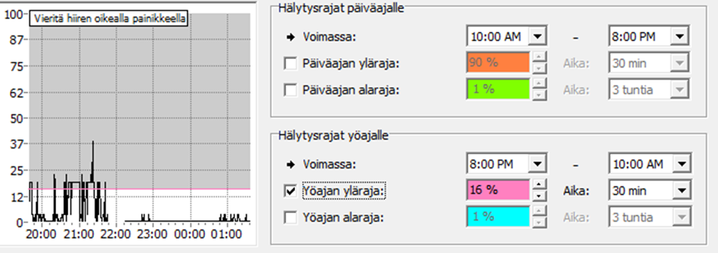
Setting the high activity alarm
In this picture the high activity alarm has been set for nights time. When activity has stayed above the pink line for more than 30minutes an alarm will be sent to the nurses phones. Both the level of activity curve alarm line and the time that activity has been over the line can be adjusted to customer needs.

Slide 6
Case exitus:
Last days of two patients in palliative care
Nurse has been present at the end
There is seen abnormal high activity bar which can be clearly differentiated from normal activity (rounded with green)
Last hours (rounded with red)

Slide 7
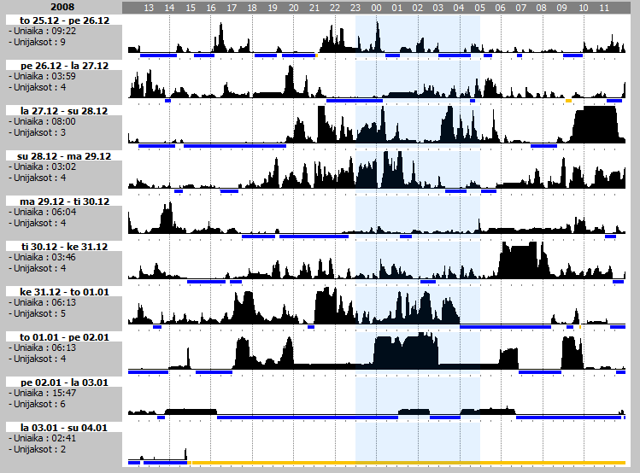
v

Slide 8
